Slide 1
STLCC Transformed
District Wide Master Plan
STLCC Service Week
Jeff L. Pittman, Ph.D.
January 10, 2022

Slide 2
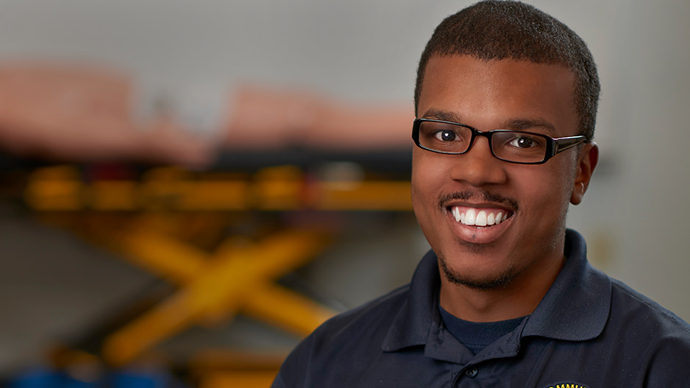

STLCC Transformed – District Wide Master Plan
The Plan includes the long-range vision for Florissant Valley, Forest Park, Meramec and the Wildwood Campuses
Each Campus Plan considers new construction, renovation and demolition

Slide 3

Transformation Planning Criteria
Ballot Language for Prop R (G5)
Student Experience and Success (G7)
Workforce and Labor Market Needs (G8)
Enrollment Trends at campuses where focus on career program needs have occurred (G8)*
  *A focus on career programs will increase interest in both technical and liberal arts classes, as it has at FP

Slide 4

Prop R - Now STLCC Transformed - Planning Teams
Chancellor’s Advisory Council
Steering Committee
Campus Committees
Graduate Committee

Slide 5

Please Note!
The Master Plan is a guide that will take place over a long period of time, with priority projects taking approximately 3 – 5 years.
All these changes will not happen at once!
Demolition/renovation will follow logistics of new construction

Slide 6


























Existing Campus Plan
FV
To Elizabeth Ave.
Pershall Road
To West Florissant Ave.
FV
1
5
Campus Map
Administration & Facilities Student Center
Library
Arts, Humanities & Theatre Communications
Social Sciences
Physical Education Science & Math
Business &
Business Administration Engineering
14
4
6
3
2
7
8
Student
Center
9
Building Key
10
13
Science and Math
Child Development Center
Service Building
Social Sciences
Communications
Theatre
Humanities
Student Center
Administration
Instructional Resources Library
Physical Education
Business & Training Center
Engineering & Emerson Center for Engineering & Manufacturing
Science & Math
Center for Workforce Innovation
Track / Soccer Field
11
12
Soccer Field
Home Plate Community Garden
N. College Dr.
Tennis Courts
N

Slide 7
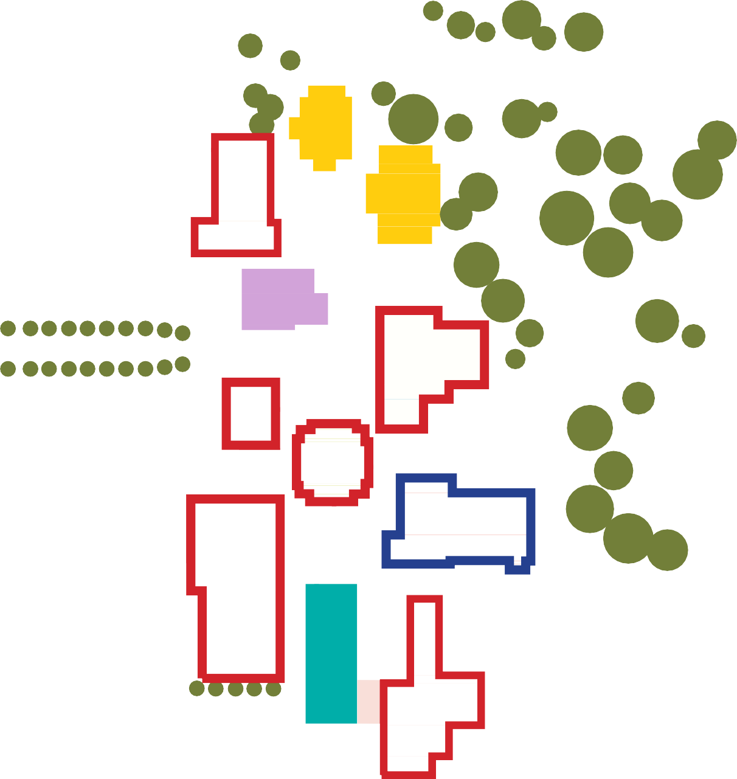



















Campus Transformation
FV
To Elizabeth Ave.
Pershall Road
To West Florissant Ave.
FV
Campus Map
Administration & Facilities Student Center
Library
Arts, Humanities & Theatre Communications
Social Sciences
Physical Education Science & Math
Business &
Business Administration Engineering
1
5
14
4
6
14
4
3
2
7
7
Building Key
8
Student
8
Center
Building to be Renovated
9
9
Building to be Demolished
13
Building to be Vacated
10
13
10
Science and Math
Child Development Center
Service Building
Social Sciences
Communications
Theatre
Humanities
Student Center
Administration
Instructional Resources Library
Physical Education
Business & Training Center
Engineering & Emerson Center for Engineering & Manufacturing
Science & Math
Center for Workforce Innovation
Track / Soccer Field
11
12
12
Soccer Field
Home Plate Community Garden
N. College Dr.
Tennis Courts
N

Slide 8
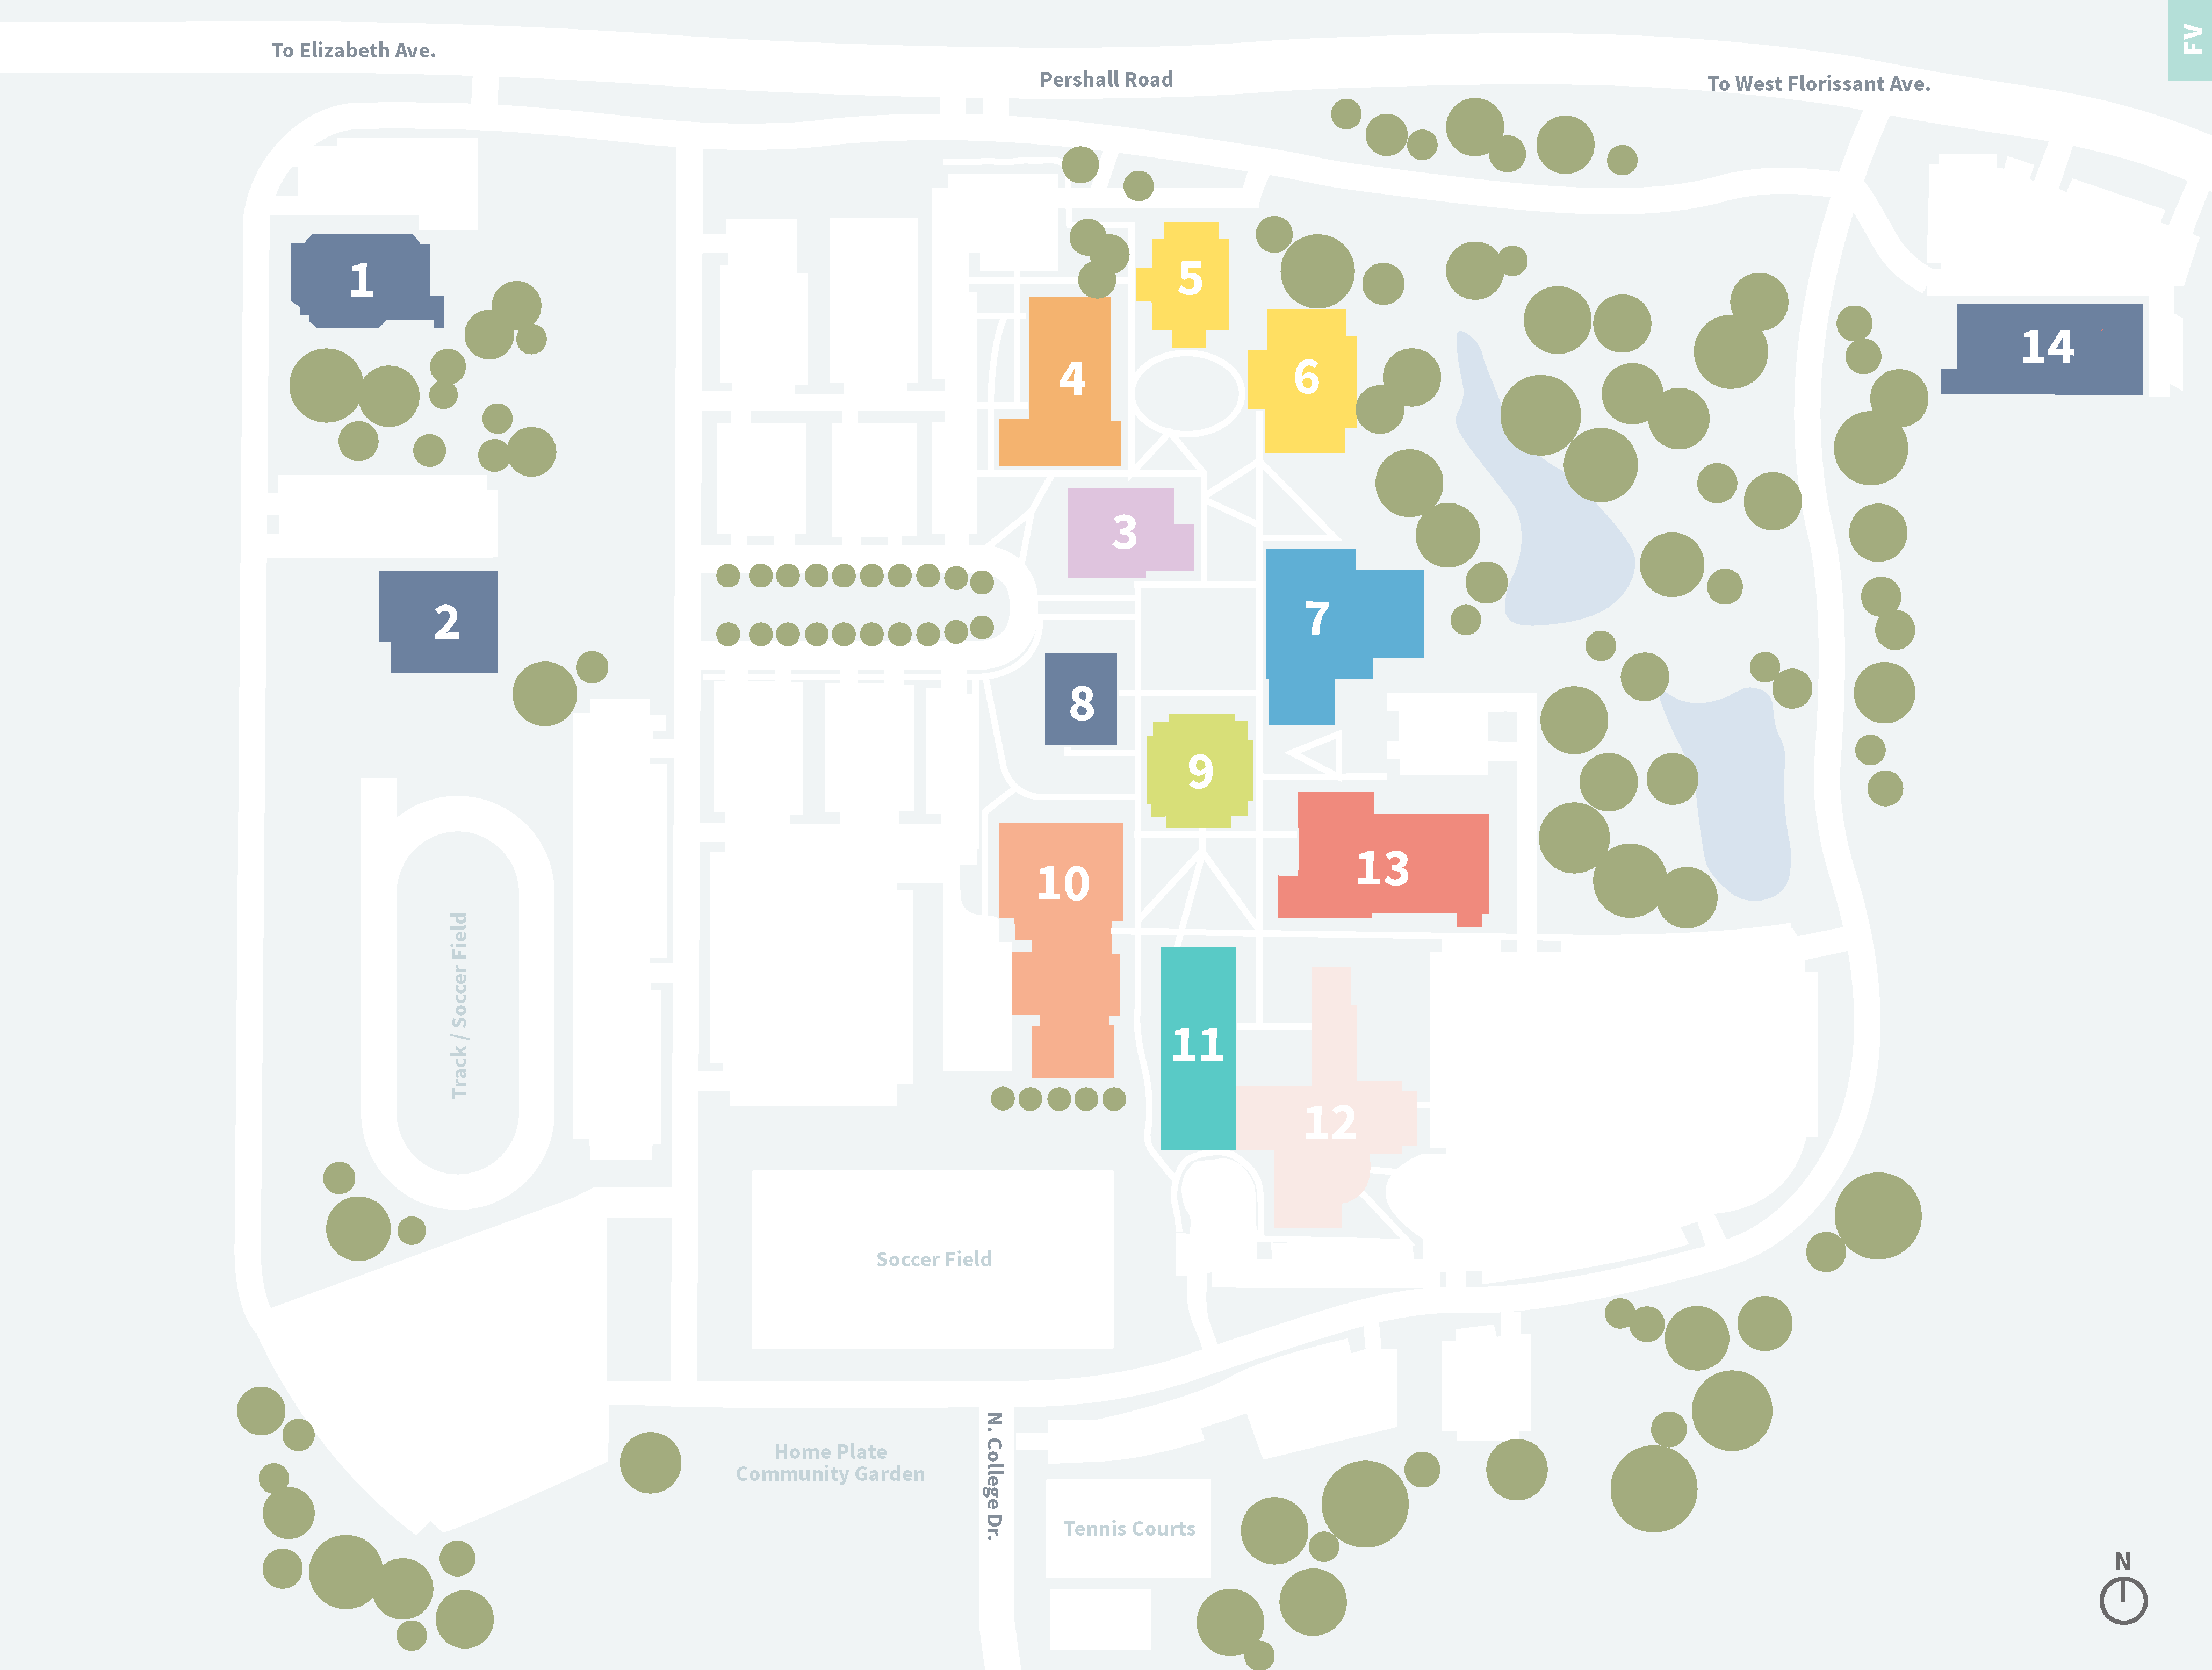



















Long-range Master Plan
FV
PERSHALL RD
FV
CENTER FOR HEALTH SCIENCES
P
Campus Map
Administration & Facilities Student Center
Library
Arts, Humanities & Theatre Communications
Social Sciences
Physical Education Science & Math
Business &
Business Administration Engineering
P
ADVANCED MANUFACTURING
PEDESTRIAN CIRCULATION
ARRIVAL PLAZA
FUTURE BUILDING SITE
QUAD/CENTRAL GREENSPACE
MINOR VEHICLE CIRCULATION
Building Key
FUTURE BUILDING SITE
Child Development Center
Service Building
Social Sciences
Communications
Theatre
Humanities
Student Center
Administration
Instructional Resources Library
Physical Education
Business & Training Center
Engineering & Emerson Center for Engineering & Manufacturing
Science & Math
Center for Workforce Innovation
P
P

Slide 9



































Existing Campus Plan
FP
FP
To Hampton Ave.
Oakland Avenue
1
2
To Kingshighway Blvd.
Campus Map
Administration &
Classroom Facilities Student Center
Library & Art Gallery Arts & Theatre
Nursing & Health Sciences Physical Education
Water Feature
3
11
12
5
4
Baseball
8
Macklind Ave.
Highlander Dr..
7
6
13
Building Key
9
College Dr.
Theatre
Library
Art Gallery
C Tower
D Tower
E Tower
F Tower
G Tower
Student Center
Hospitality Studies Center
Center for Nursing & Health Sciences
Physical Education
Parking Garage
Art Annex
Highland Park Building - Facilities
10
14
Highland Park Dr.
15
Wise Ave.
Manchester Blvd.
N

Slide 10
























Campus Transformation
FP
FP
To Hampton Ave.
1
Oakland Avenue
1
2
2
To Kingshighway Blvd.
3
Campus Map
Administration &
Classroom Facilities Student Center
Library & Art Gallery Arts & Theatre
Nursing & Health Sciences Physical Education
Water Feature
3
11
5
12
DEMO
5
4
BALL FIELD
4
12
Baseball
8
Macklind Ave.
8
7
7
6
Highlander Dr..
6
13
9
Building Key
9
College Dr.
Building to be Renovated
Building to be Demolished Building to be Vacated
Theatre
Library
Art Gallery
C Tower
D Tower
E Tower
F Tower
G Tower
Student Center
Hospitality Studies Center
Center for Nursing & Health Sciences
Physical Education
Parking Garage
Art Annex
Highland Park Building - Facilities
1
0
10
1
4
14
Highland Park Dr.
1
5
1
5
Wise Ave.
Manchester Blvd.
N

Slide 11
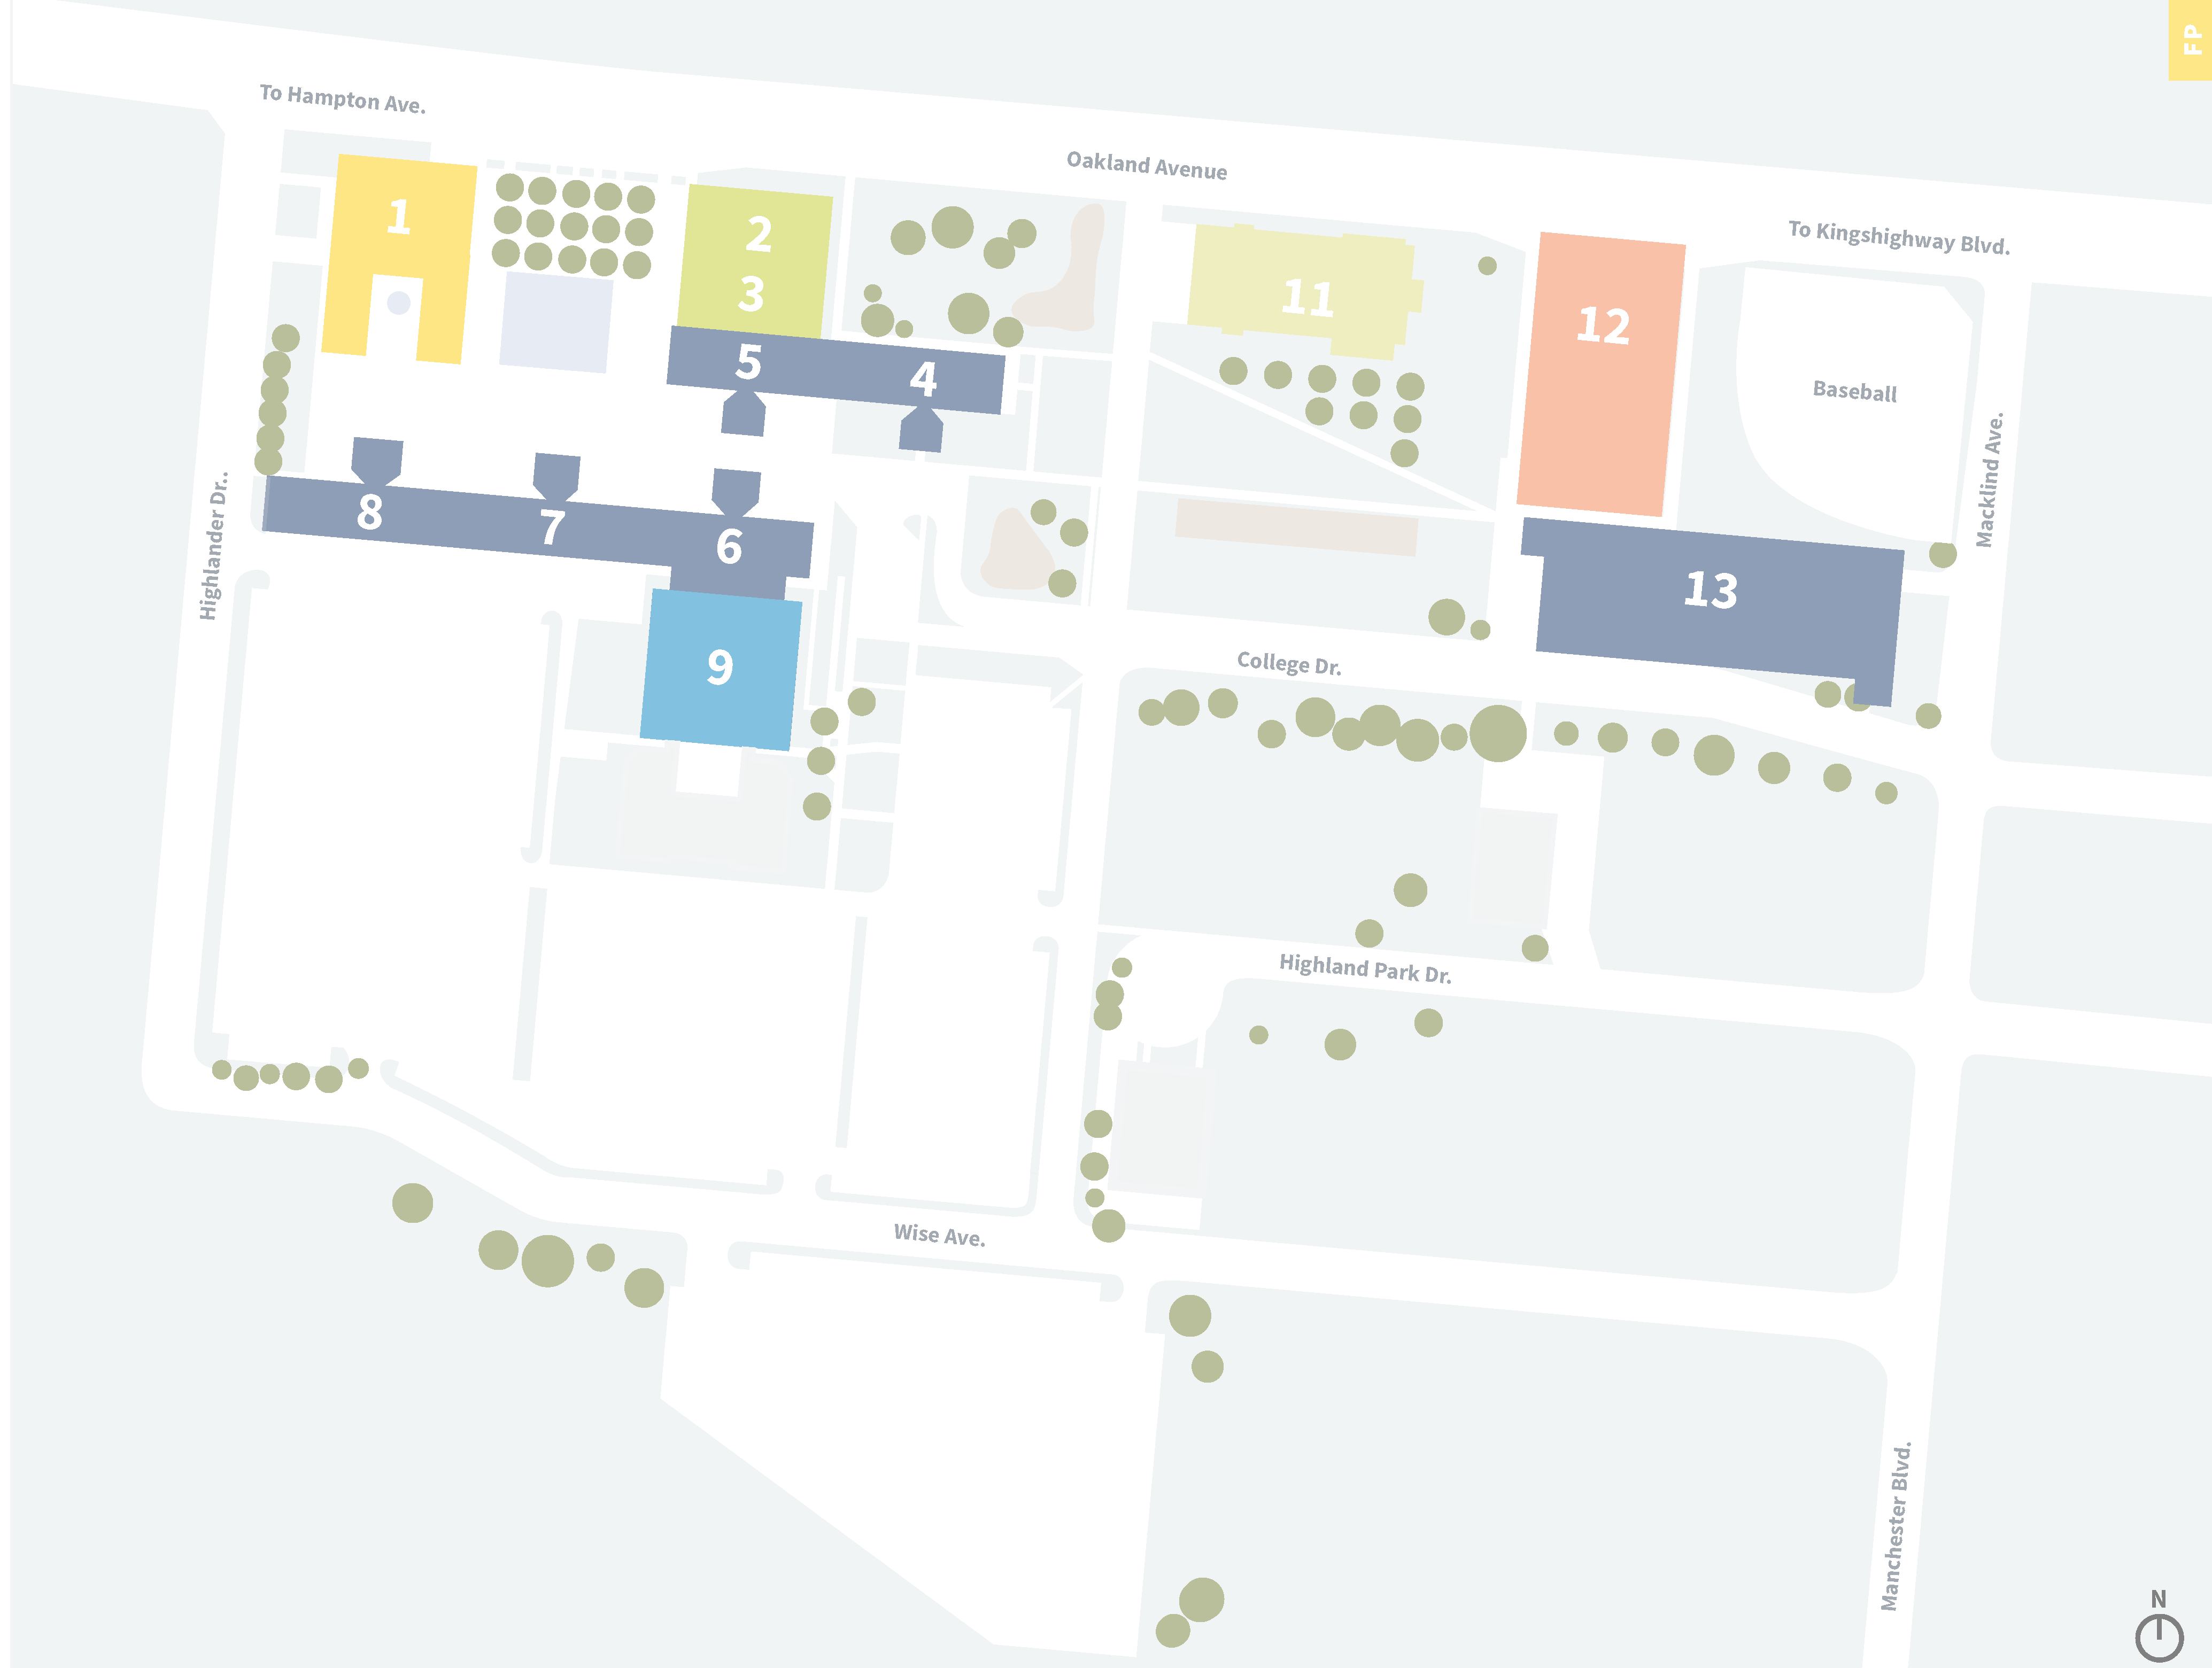

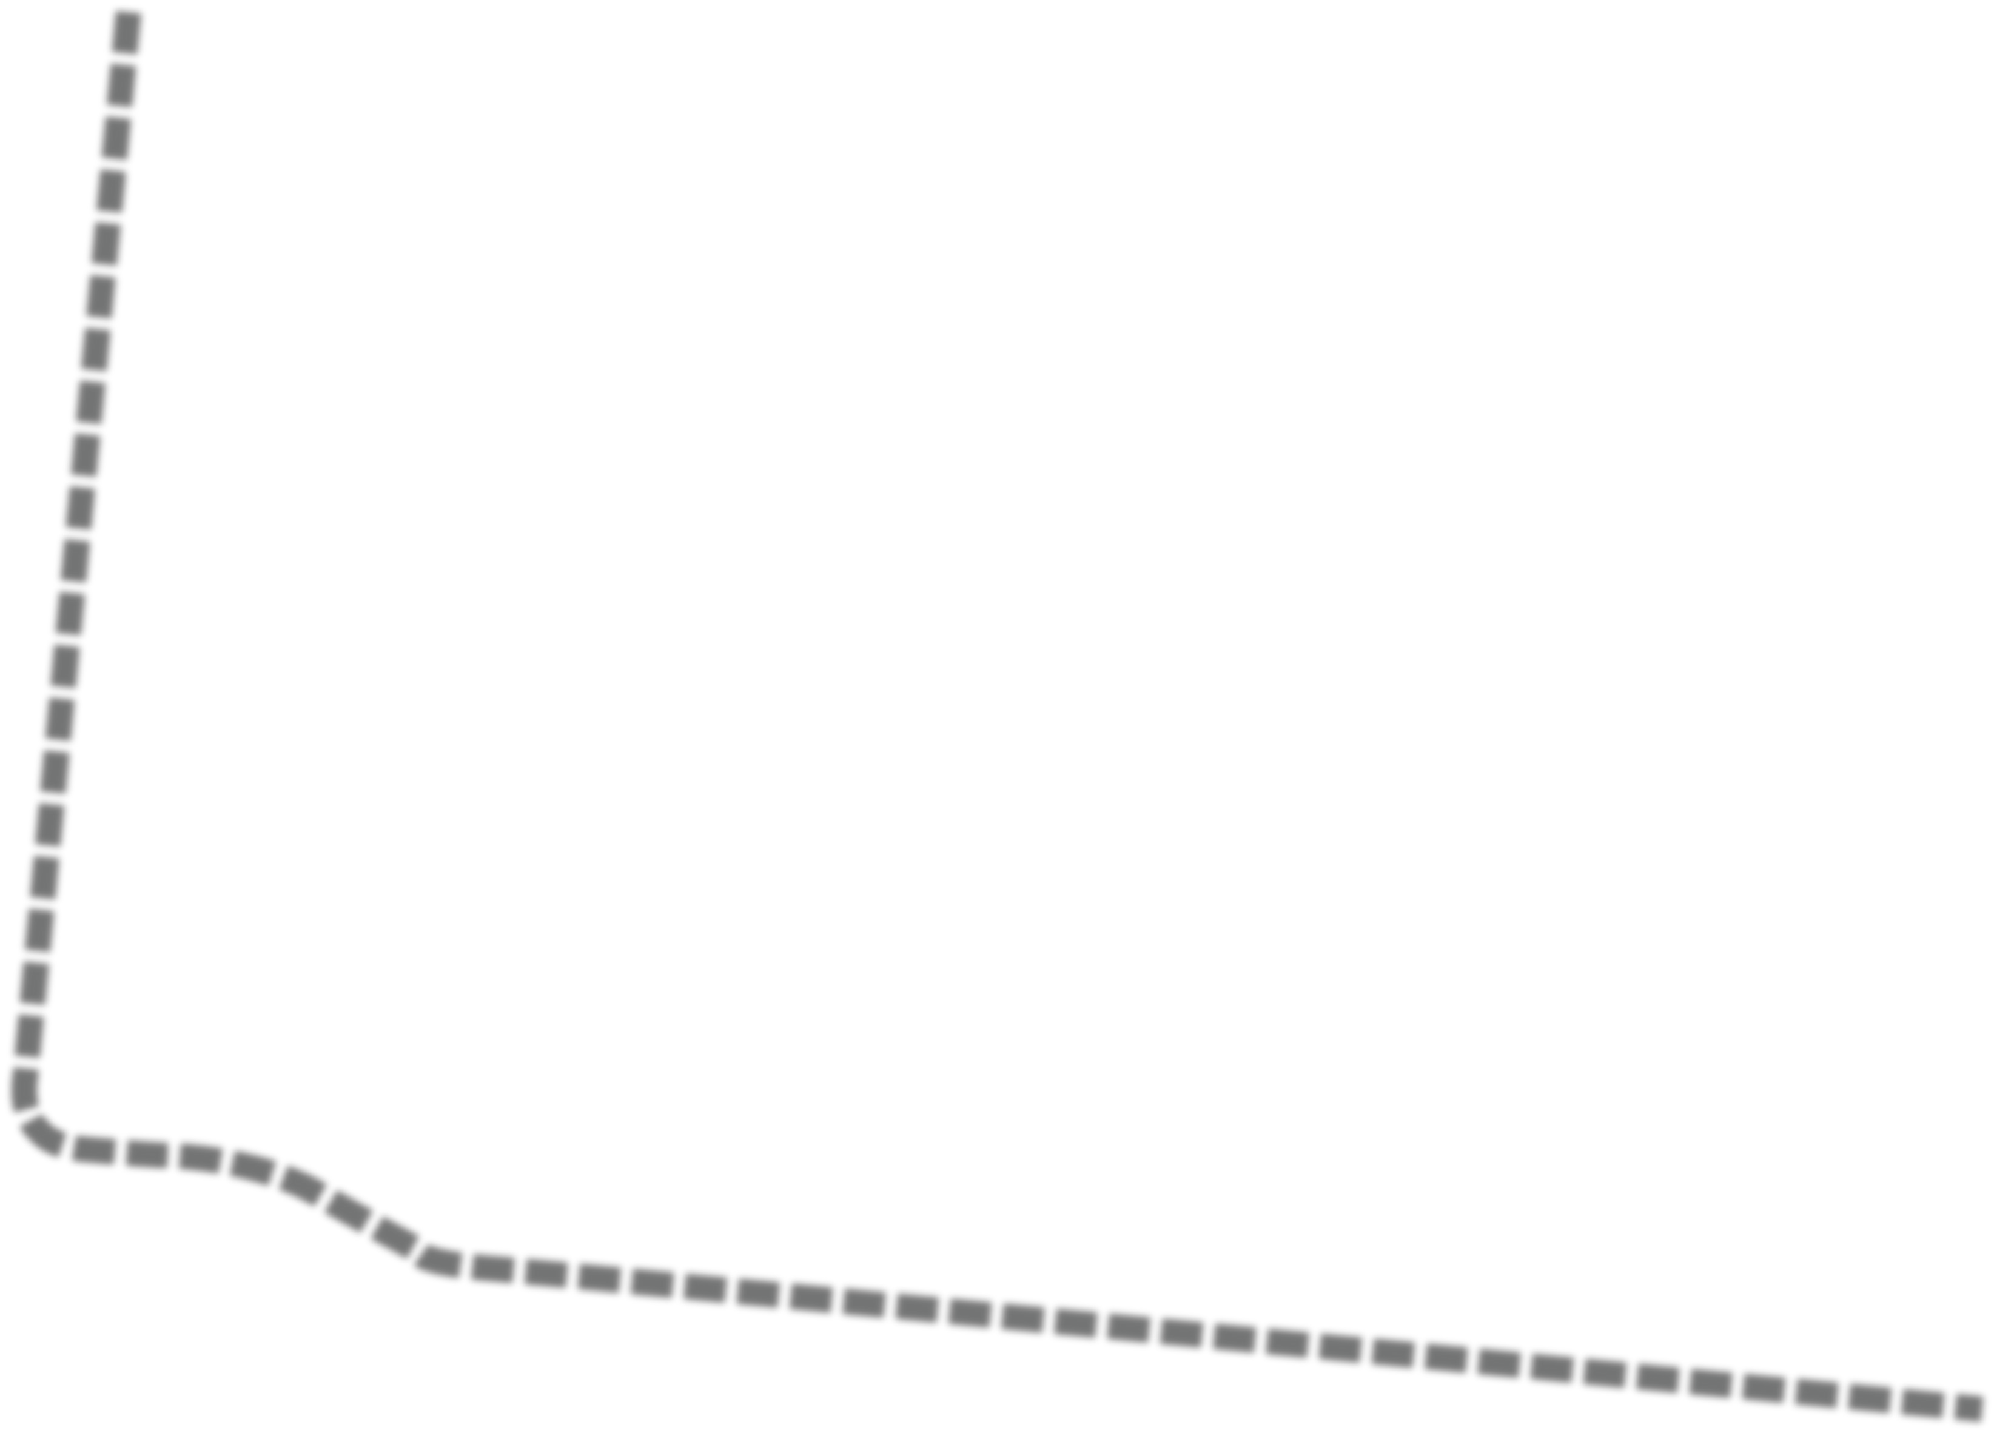
















Long-range Master Plan
FP
FP
BUS SHELTER
OAKLAND AVE
Campus Map
Administration &
Classroom Facilities Student Center
Library & Art Gallery Arts & Theatre
Nursing & Health Sciences Physical Education
Water Feature
Building Key
Theatre
Library
Art Gallery
C Tower
D Tower
E Tower
F Tower
G Tower
Student Center
Hospitality Studies Center
Center for Nursing & Health Sciences
Physical Education
Parking Garage
Art Annex
Highland Park Building - Facilities
SOUTH DR
MACKLAND AVE
HOSPITALITY
HIGHLANDER DR
ARRIVAL
MANAGEMENT
PLAZA/
PEDESTRIAN CIRCULATION
ADD LANDSCAPING
COLLEGE DR
AND LIGHTING TO
PARKING LOTS
P
P
TRANSPORTATION
CENTER
FLEET PARKING
WISE AVE
TRUCK DRIVING
PROGRAM LOT

Slide 12








Existing Campus Plan
M
MER
Campus Map
Administration & Facilities Continuing Education
Student Center Library
Arts, Humanities & Theatre Communications
Social Sciences
Physical Education Science & Math
Business & Business Administration
Applied Science
Building Key
Rose Hill Ave.
Soccer & Track
1
Baseball
Physical Plant
So ball
3
4
2
5
12
11
Meramec Theater
Geyer Road
Couch Ave.
13
6
7
Humanities East
18
Campus Police
Continuing Education
Physical Plant
Power House
Student Center
Applied Science
Science West
Science South
Greenhouse
Lecture Hall
Humanities West
Theatre
Humanities East
Communications North
Communications South
Library
Administration & Clark Hall
Physical Education
Business Administration
Social Sciences
Physical Education
10
8
14
17
15
Business Administration
16
19
20
9
To I-270
Big Bend Road
To I-44
N

Slide 13








Campus Transformation
M
MER
Campus Map
Administration & Facilities Continuing Education
Student Center Library
Arts, Humanities & Theatre Communications
Social Sciences
Physical Education Science & Math
Business & Business Administration
Applied Science
Building Key
Rose Hill Ave.
Soccer & Track
1
Baseball
1
Physical Plant
So ball
3
4
2
5
2
5
12Theater
Meramec
Geyer Road
Building to be Renovated
Couch Ave.
12
13
14
6
7
11
Humanities East
Building to be Demolished
₁E₈ducation
18
Physical
Building to be Vacated
Campus Police
Continuing Education
Physical Plant
Power House
Student Center
Applied Science
Science West
Science South
Greenhouse
Lecture Hall
Humanities West
Theatre
Humanities East
Communications North
Communications South
Library
Administration & Clark Hall
Physical Education
Business Administration
Social Sciences
10
8
17
17
15
16
15
Administr₁₉ation Business
16
19
20
9
20
To I-270
Big Bend Road
To I-44
N

Slide 14
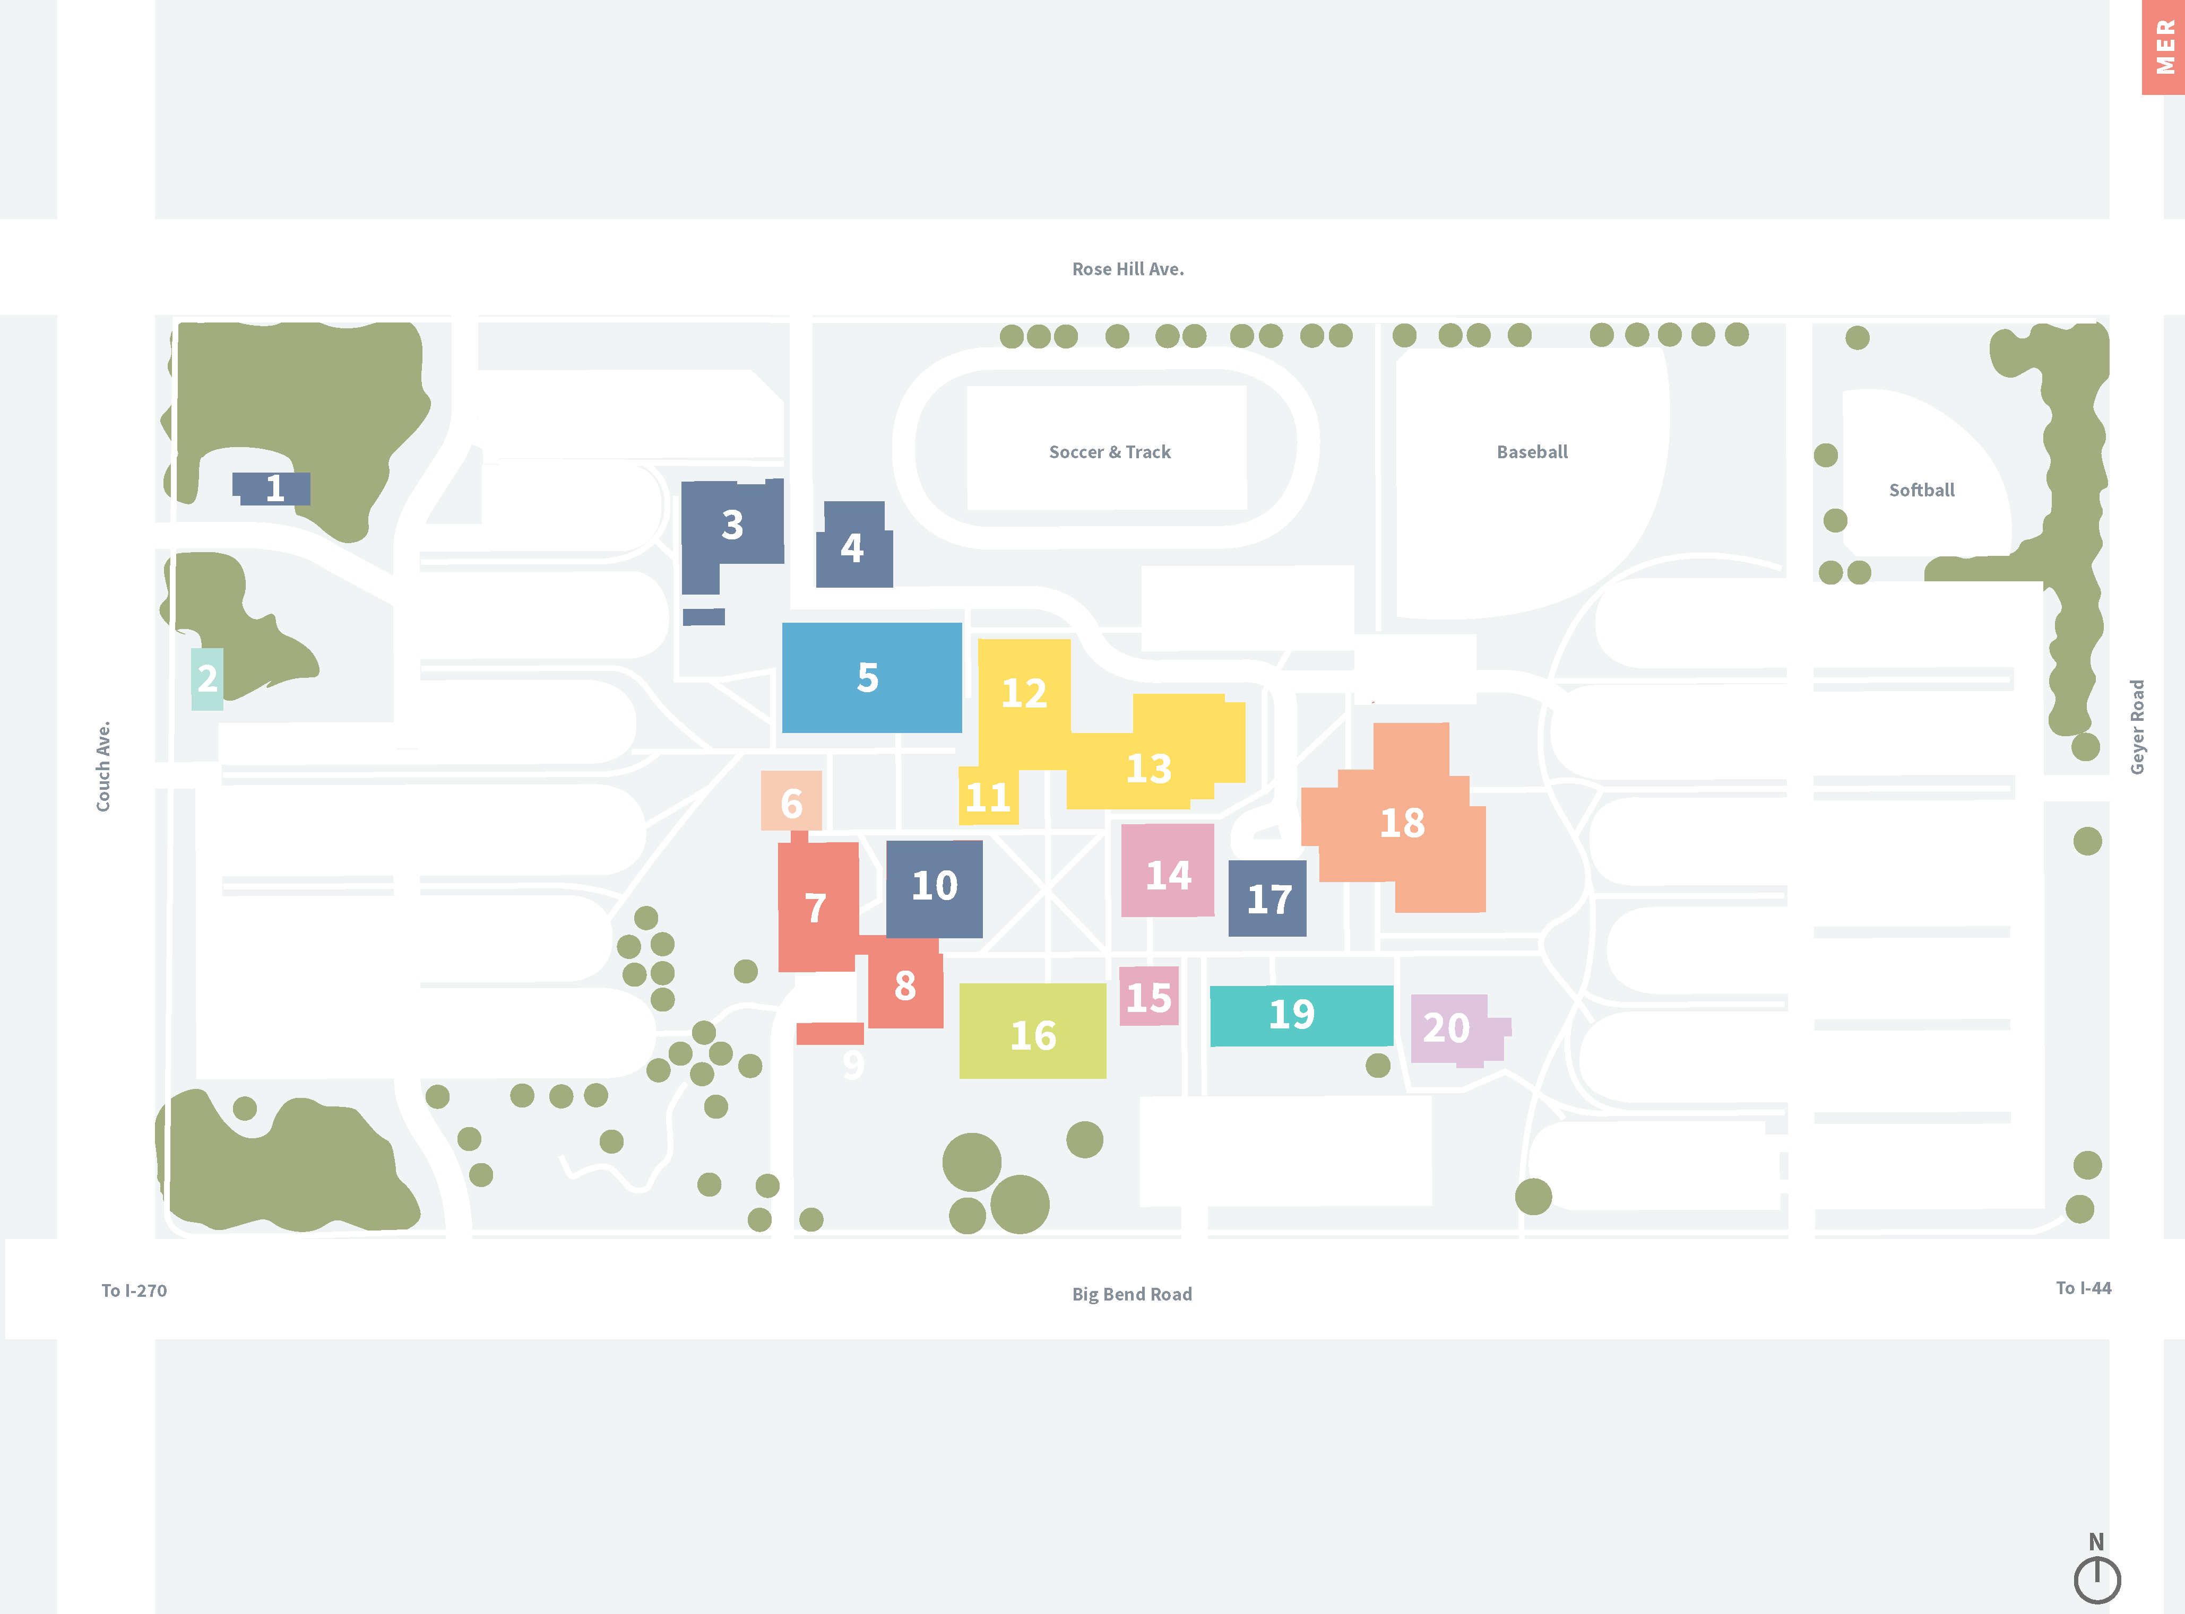

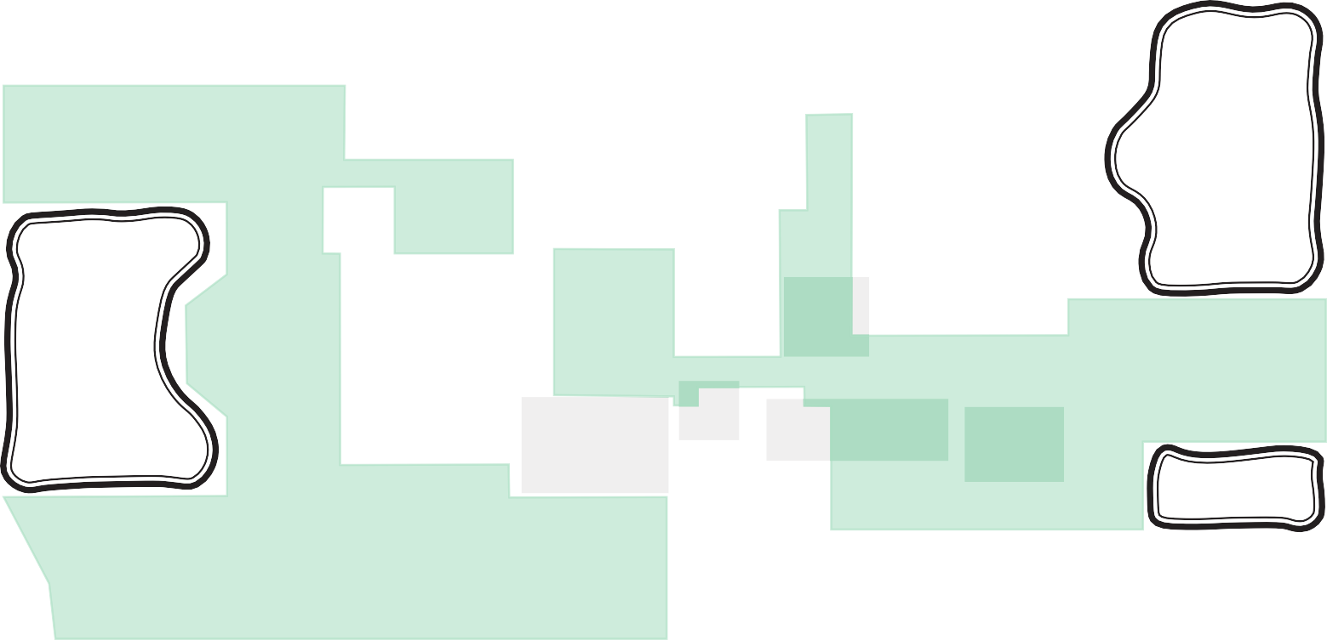











Long-range Master Plan
M
Campus Map
Administration & Facilities Continuing Education
Student Center Library
Arts, Humanities & Theatre Communications
Social Sciences
Physical Education Science & Math
Business & Business Administration
Applied Science
ROSE HILL AVE
P
GEYER RD
FUTURE BUILDING SITE
COUCH AVE
WIND AND SOLAR FARM
P
P
Building Key
Campus Police
Continuing Education
Physical Plant
Power House
Student Center
Applied Science
Science West
Science South
Greenhouse
Lecture Hall
Humanities West
Theatre
Humanities East
Communications North
Communications South
Library
Administration & Clark Hall
Physical Education
Business Administration
Social Sciences
NEW ENTRY SEQUENCE
P
P
PEDESTRIAN CIRCULATION
SUSTAIN- ABILITY
& ENERGY SCIENCE
ARRIVAL PLAZA
FINANCE & BUSINESS
ADMIN
FUTURE BUILDING SITE
P
P
PLANT SCIENCE OUTDOOR CLASSROOMS
REVERT PARKING BACK TO GREENSPACE
BIG BEND RD

Slide 15

WW Existing Campus Plan
WW
Campus Map
Wildwood Campus Building
New College Avenue
Highway 109
1
I-44
Generations Drive
N
N

Slide 16
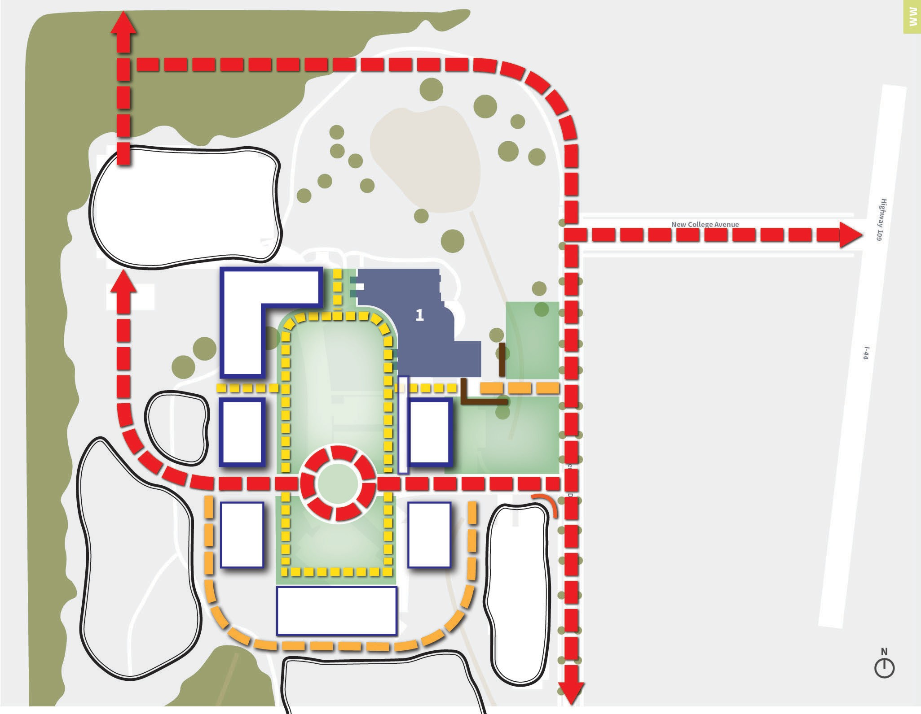
WW Long-range Master Plan
CONNECTION TO MANCHESTER
Campus Map
Wildwood Campus Building
P
CENTER FOR HEALTH SCIENCES
SCREENING
QUAD/CENTRAL GREENSPACE
LOADING
P
FUTURE BUILDING SITE
CENTER FOR TECHNOLOGY STUDIES
LANDSCAPE/ PLACEMAKING OPPORTUNITY (SCREEN LOADING)
ARRIVAL
SIGNAGE OPPORTUNITY
FUTURE BUILDING SITE
FUTURE BUILDING SITE
P
P
FUTURE BUILDING SITE
P

Slide 17
Phase 1 Priority Projects

Slide 18
Florissant Valley – Phase 1 Priority Projects
New Construction
  Center for Health Sciences
  Advanced Manufacturing Center
Renovation
  Relocate existing programming & radio station
Demolish Antiquated Facilities
  Communications
  Emerson Center for Engineering
Vacate Decentralized Properties
  Center for Workforce Innovation

Slide 19
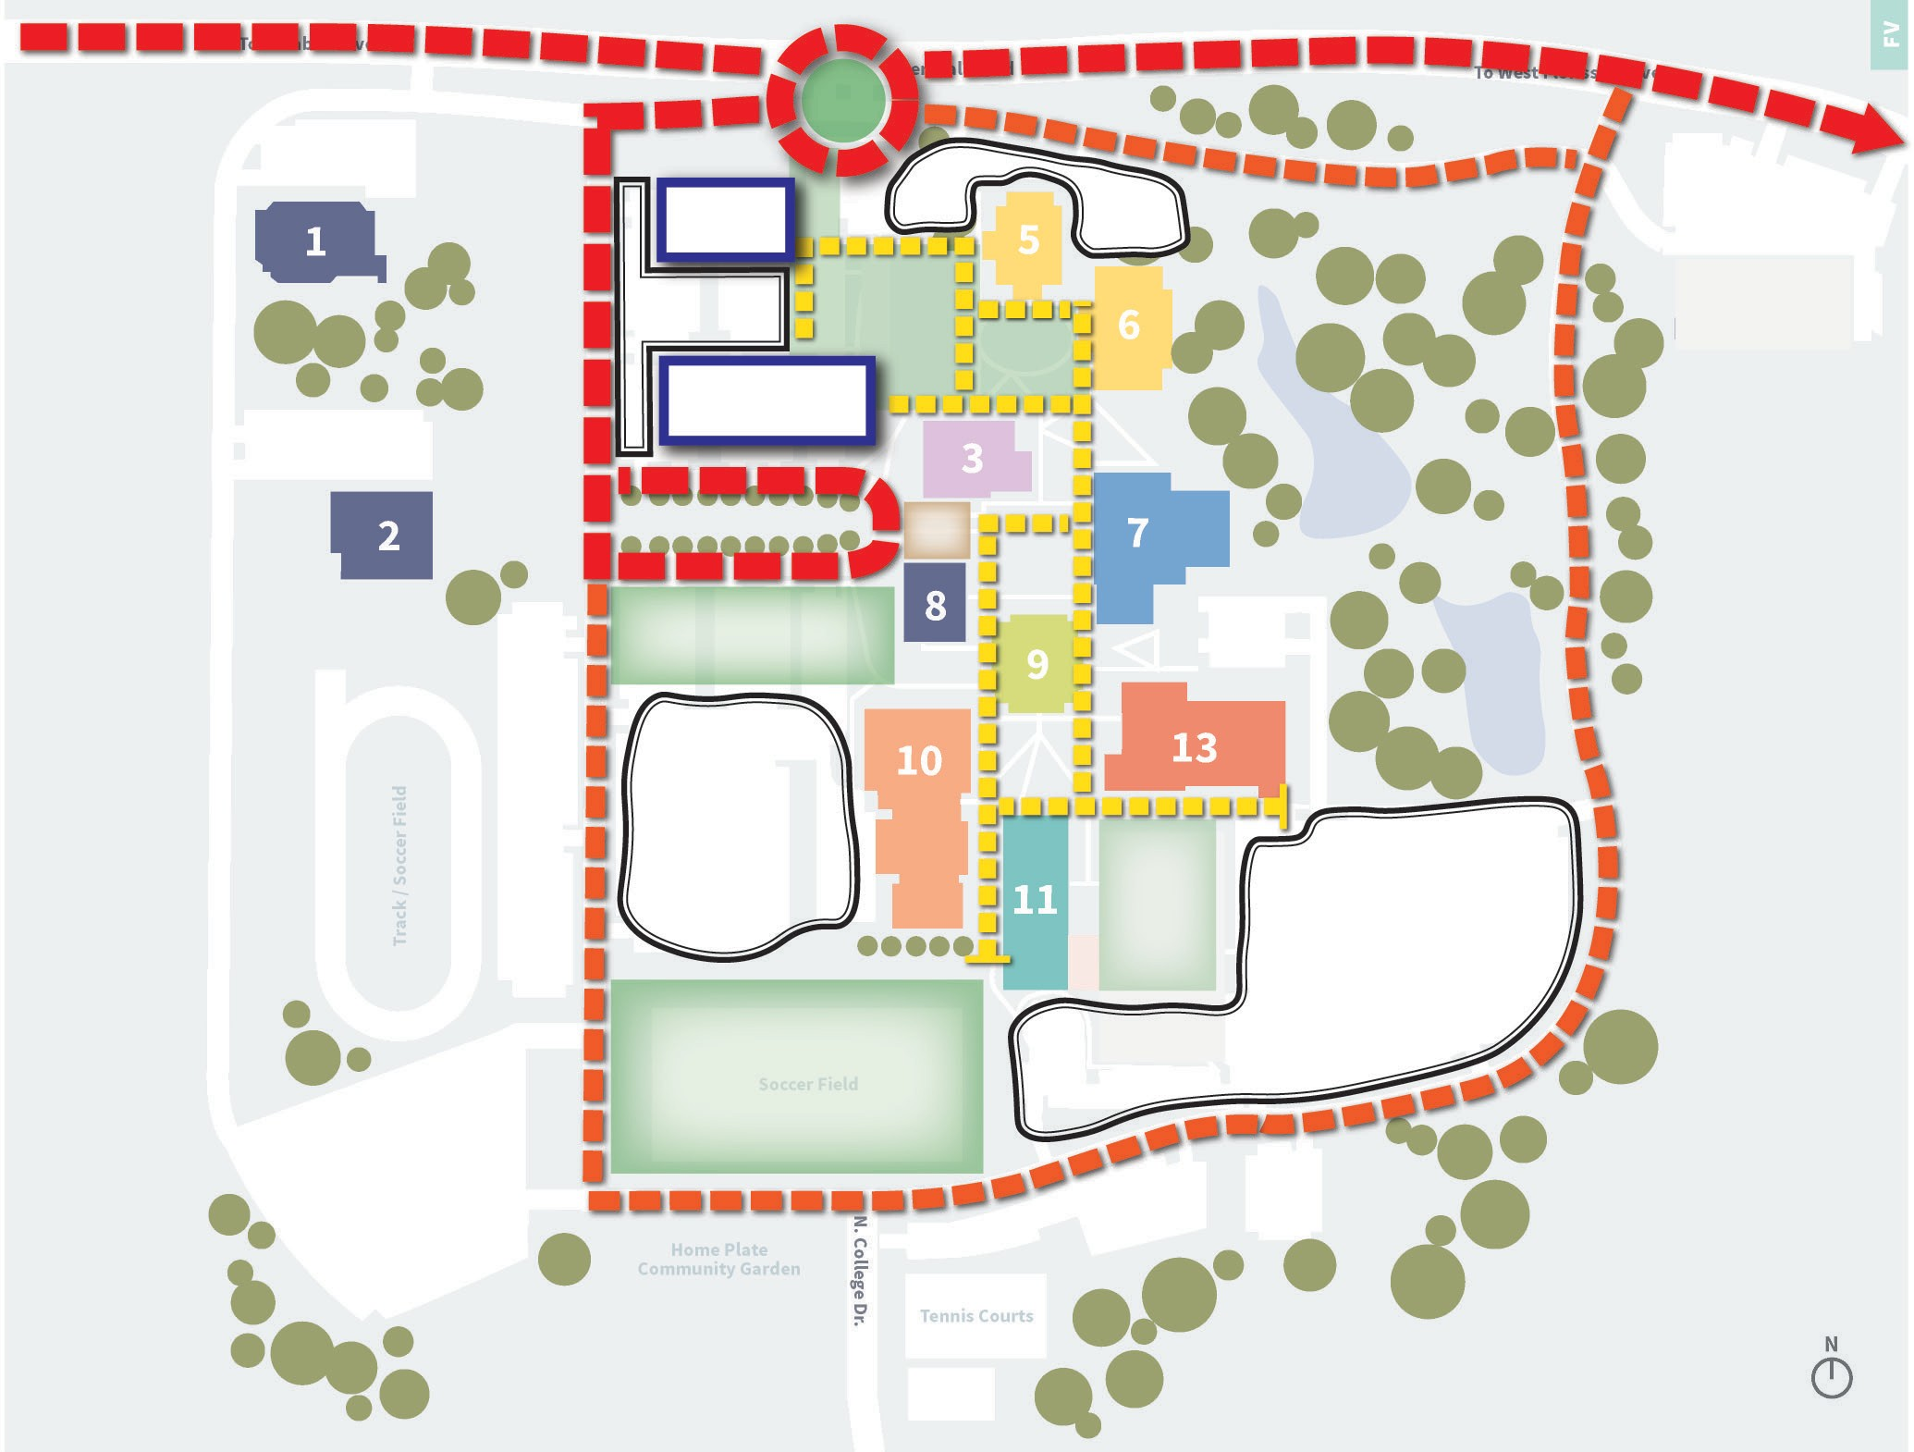
Phase 1 Priority Projects
FV
CENTER FOR HEALTH SCIENCES
Campus Map
Administration & Facilities Student Center
Library
Arts, Humanities & Theatre Communications
Social Sciences
Physical Education Science & Math
Business &
Business Administration Engineering
P
ADVANCED MANUFACTURING
GREENSPACE
PEDESTRIAN CIRCULATION
ARRIVAL PLAZA
Building Key
Child Development Center
Service Building
Social Sciences
Communications
Theatre
Humanities
Student Center
Administration
Instructional Resources Library
Physical Education
Business & Training Center
Engineering & Emerson Center for Engineering & Manufacturing
Science & Math
Center for Workforce Innovation
P
P

Slide 20
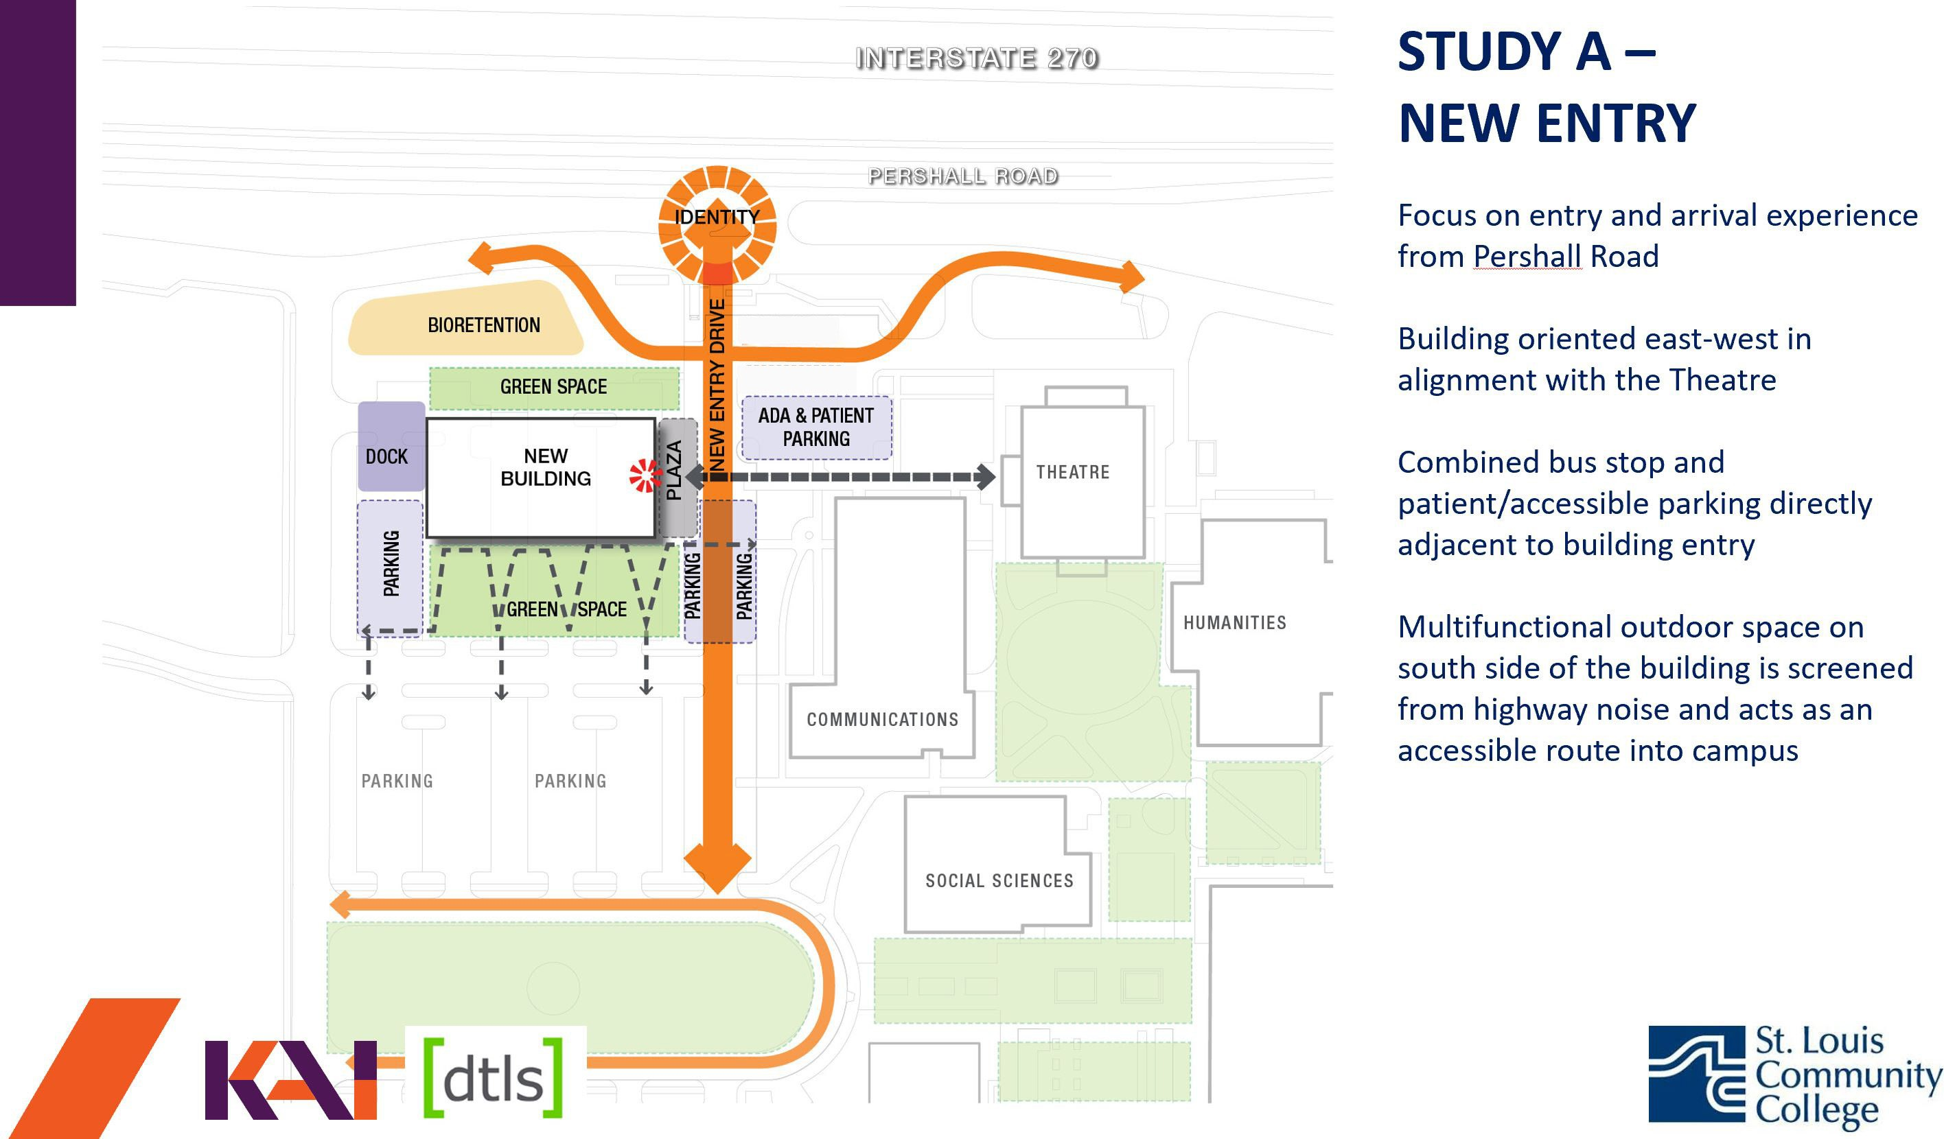
Phase 1 Priority Projects - PROGRESS
FV

Slide 21
Forest Park– Phase 1 Priority Projects
New Construction
  Transportation Center
  Hospitality Management & Business Center
Renovation
  Relocate existing programming
Demolish Antiquated Facilities
  Hospitality Studies Facility
Vacate Decentralized Properties
  Art Annex
  Highland Park Building

Slide 22



Phase 1 Priority Projects
FP
FP
BUS SHELTER
OAKLAND AVE
Campus Map
Administration &
Classroom Facilities Student Center
Library & Art Gallery Arts & Theatre
Nursing & Health Sciences Physical Education
Water Feature
Building Key
Theatre
Library
Art Gallery
C Tower
D Tower
E Tower
F Tower
G Tower
Student Center
Hospitality Studies Center
Center for Nursing & Health Sciences
Physical Education
Parking Garage
Art Annex
Highland Park Building - Facilities
SOUTH DR
MACKLAND AVE
HOSPITALITY
HIGHLANDER DR
ARRIVAL
MANAGEMENT
PLAZA/
PEDESTRIAN CIRCULATION
ADD LANDSCAPING
COLLEGE DR
AND LIGHTING TO
PARKING LOTS
P
P
TRANSPORTATION
CENTER
FLEET PARKING
WISE AVE
TRUCK DRIVING
PROGRAM LOT

Slide 23
Meramec – Phase 1 Priority Projects
New Construction
  Finance Administration & Business Accelerator
  Sustainable Energy Sciences Center
  Plant Science greenhouse + outdoor classrooms
Renovation
  Relocate existing programming
Demolish Antiquated Facilities
  Communications South
  Social Sciences
  Business Administration
  Clark Hall
  Library
  Houses (Campus Police & Continuing Ed)

Slide 24
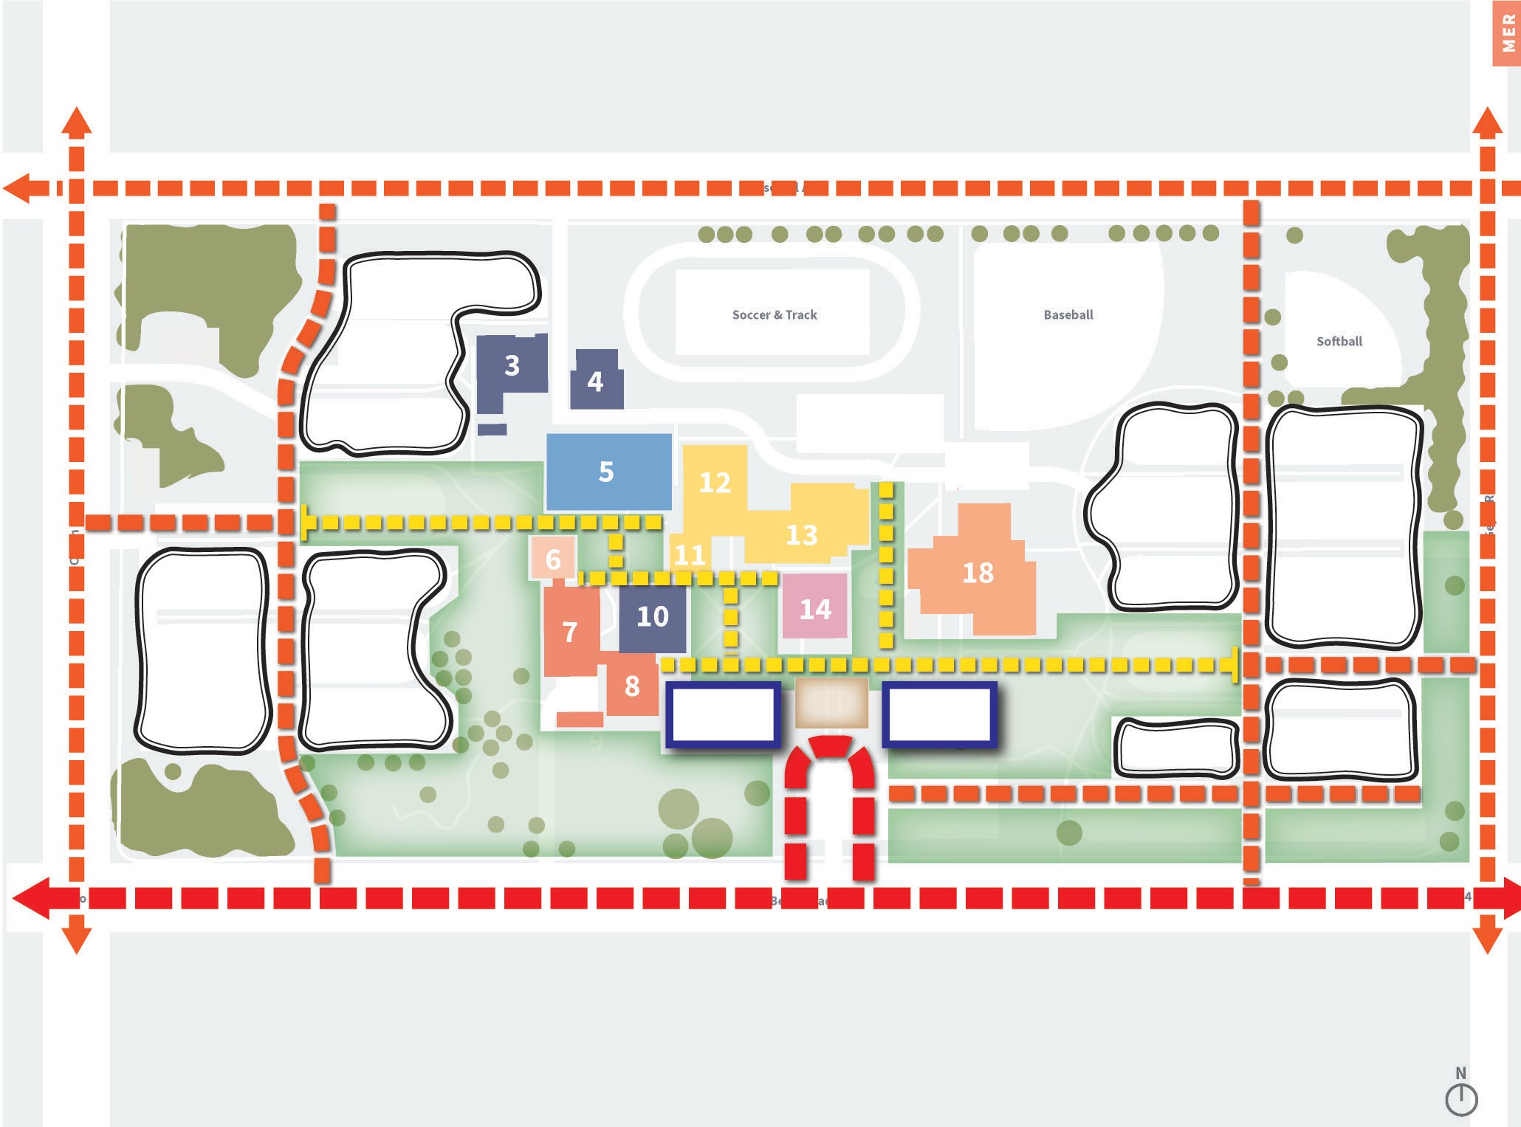
Phase 1 Priority Projects
M
Campus Map
Administration & Facilities Continuing Education
Student Center Library
Arts, Humanities & Theatre Communications
Social Sciences
Physical Education Science & Math
Business & Business Administration
Applied Science
ROSE HILL AVE
P
GEYER RD
COUCH AVE
WIND AND SOLAR FARM
P
P
Building Key
Campus Police
Continuing Education
Physical Plant
Power House
Student Center
Applied Science
Science West
Science South
Greenhouse
Lecture Hall
Humanities West
Theatre
Humanities East
Communications North
Communications South
Library
Administration & Clark Hall
Physical Education
Business Administration
Social Sciences
NEW ENTRY SEQUENCE
P
P
PEDESTRIAN CIRCULATION
SUSTAIN- ABILITY
& ENERGY SCIENCE
ARRIVAL PLAZA
FINANCE & BUSINESS
ADMIN
P
P
PLANT SCIENCE OUTDOOR CLASSROOMS
REVERT PARKING BACK TO GREENSPACE
BIG BEND RD

Slide 25
Wildwood – Phase 1 Priority Projects
New Construction
  Center for Health Sciences
  Center for Technology Studies
Renovation
  Selective within existing building

Slide 26
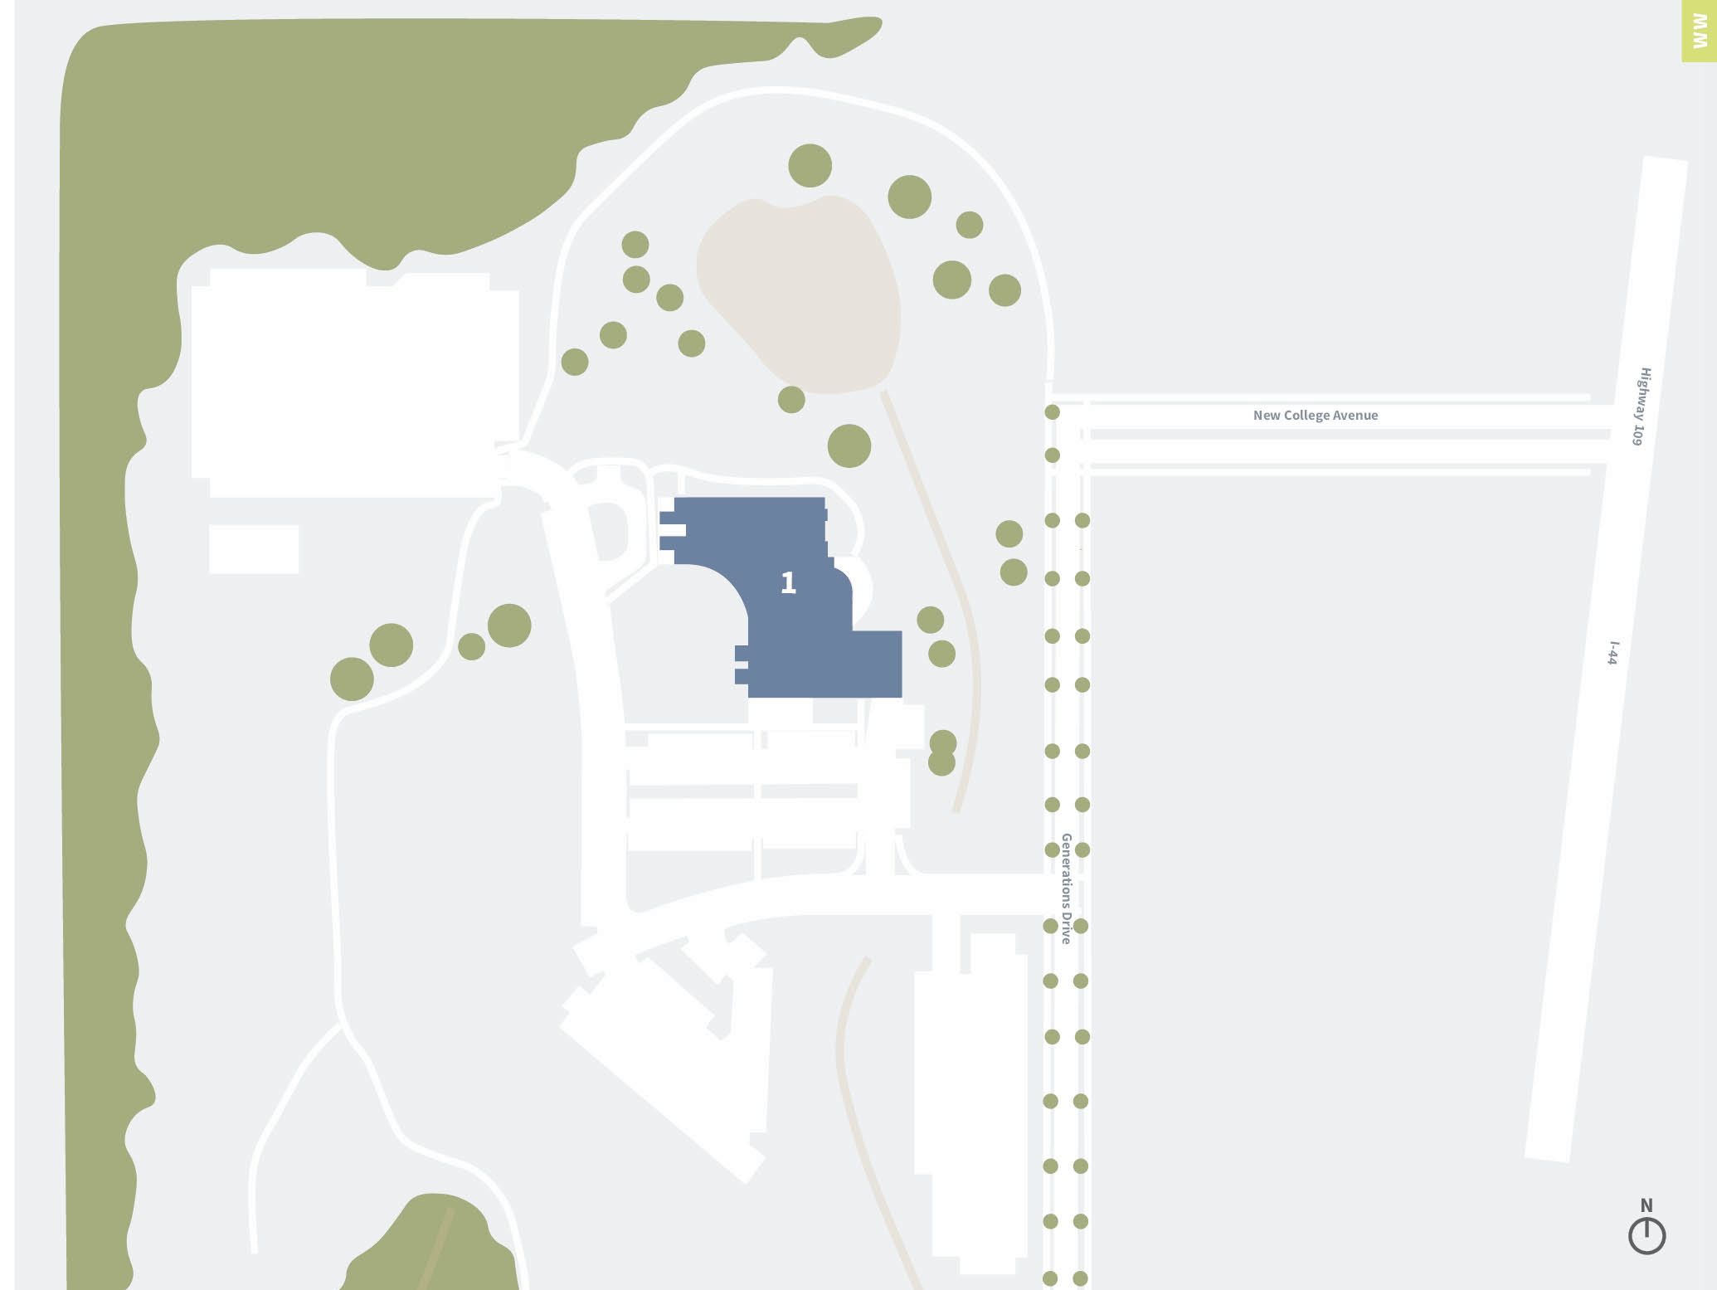
















WW Phase 1 Priority Projects
CONNECTION TO MANCHESTER
Campus Map
Wildwood Campus Building
P
CENTER FOR HEALTH SCIENCES
SCREENING
QUAD/CENTRAL GREENSPACE
LOADING
P
CENTER FOR TECHNOLOGY STUDIES
LANDSCAPE/ PLACEMAKING OPPORTUNITY (SCREEN LOADING)
ARRIVAL
SIGNAGE OPPORTUNITY
P
P

Slide 27
Phase 1 Priority Projects: Conceptual Cost
Project | SF ‐ Prelim | Cost
FLORISSANT VALLEY
Center for Health Sciences | 100,000 | 40,000,000
Advanced Mfg Center | 100,000 | 40,000,000
Demolition & Renovation |  | 8,000,000
FV Subtotal |  |  | 88,000,000
FOREST PARK
Hospitality Mgmt & Business Center | 50,000 | 20,000,000
Transporation Center | 75,000 | 30,000,000
Demolition & Renovation |  | 7,500,000
FP Subtotal |  |  | 57,500,000
MERAMEC
Finance Administration & Business Accelerator | 50,000 | 20,000,000
Sustainable Energy Sciences Center | 50,000 | 20,000,000
Plant Science Greenhouse & Outdoor Classrooms |  | 2,500,000
Demolition & Renovation |  | 20,000,000
MER Subtotal |  |  | 62,500,000
WILDWOOD
Center for Health Sciences | 75,000 | 30,000,000
Center for Technlogy Studies | 75,000 | 30,000,000
Renovation |  | 2,500,000
WW Subtotal |  |  | 62,500,000
Subtotal (All Campuses) |  |  | 270,500,000
Escalation ‐ 5% |  |  | 13,525,000
Contingency ‐ 10% |  |  | 28,402,500
Estimated Construction Total |  |  | 312,427,500
A/E Fees (estimated) |  |  | 21,869,925
FF&E (estimated) |  |  | 46,864,125
Estimated Capital Projects Total (Phase 1 Priority 1) |  |  | 381,161,550
FV
FP M
WW
*Costs are preliminary only

Slide 28

Phase 1 Priority Projects: Delivery Approach
ALL CAMPUSES
ST. LOUIS COMMUNITY COLLEGE TRANSFORMATION STEERING COMMITTEEE
FV
FP
M
WW
STLCC PLANNING TEAM
STLCC PLANNING TEAM
STLCC PLANNING TEAM
STLCC PLANNING TEAM
CONSTRUCTION MANAGER #1
CONSTRUCTION MANAGER #2
CONSTRUCTION MANAGER #3
CONSTRUCTION MANAGER #4
DESIGN TEAM PROJECT #1
DESIGN TEAM PROJECT #2
DESIGN TEAM PROJECT #3
DESIGN TEAM PROJECT #1
DESIGN TEAM PROJECT #2
DESIGN TEAM PROJECT #3
DESIGN TEAM PROJECT #1
DESIGN TEAM PROJECT #2
DESIGN TEAM PROJECT #3
DESIGN TEAM PROJECT #1
DESIGN TEAM PROJECT #2
DESIGN TEAM PROJECT #3

Slide 29
Phase 1 Priority Projects: Preliminary Schedule
ALL CAMPUSES
WE ARE HERE!
MERAMEC CAMPUS WILL REQUIRE EARLY DEMO
PRE-DESIGN
CM TEAMS IDENTIFIED DESIGN TEAMS IDENTIFIED
DESIGN - NEW BLDGS
STAGGERED COMMENCEMENT DATES FOR PROJECTS
CONSTRUCTION - NEW BLDGS
GROUND-UP NEW CONSTRUCTION
OCCUPANCY
DEMO
DESIGN - RENOVATIONS
CONSTRUCTION - RENOVATIONS
OCCUPANCY
Q1
Q2
Q3
Q4
Q1
Q2
Q3
Q4 Q1
Q2
Q3
Q4 Q1
Q2
Q3
Q4
2022
2023
2024
2025

Slide 30
Thank You!

